Slide 1
Introduction to Databases
Dr. Shaheen Khatoon
Shaheen.Khatoon@xjtlu.edu.cn

Slide 2
Chapter 8
ERD- Advanced Concepts

Slide 3
Chapter Outline
This lesson covers the following objectives:
  Define and give an example of a subtype
  Define and give an example of a supertype
  State the rules relating to entities and subtypes, and give examples of each
  Apply the rules of supertype and subtype by evaluating the accuracy of ER diagrams that represent them
  Apply the rules of supertype and subtype and include them in a diagram when appropriate
  Appy rules of Exclusive OR Relationship

Slide 4
Purpose
Supertypes and subtypes occur frequently in the real world:
  food order types (eat in, to go)
  grocery bag types (paper, plastic)
  payment types (check, cash, credit)
You can typically associate ‘choices’ of something with supertypes and subtypes
For example, what will be the method of payment – cash, check or credit card?
Understanding real-world examples helps us understand how and when to model them

Slide 5
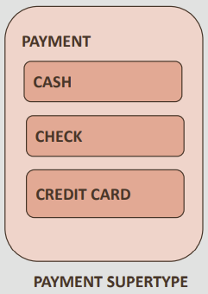
Evaluating Entities
Often some instances of an entity have attributes and/or relationships that other instances do not have
Imagine a business which needs to track payments from customers
Customers can pay by cash, by check, or by credit card

Slide 6
Evaluating Entities
All payments have some common attributes: payment date, payment amount, and so on
But only credit cards would have a “card number” attribute
And for credit card and check payments, we may need to know which CUSTOMER made the payment, while this is not needed for cash payments

Slide 7
Evaluating Entities
All payments have some common attributes: payment date, payment amount, and so on
Should we create a single PAYMENT entity or three separate entities CASH, CHECK, and CREDIT CARD?
And what happens if in the future we introduce a fourth method of payment?

Slide 8
Subdivide an Entity
Sometimes it makes sense to subdivide an entity into subtypes
This may be the case when a group of instances has special properties, such as attributes or relationships that exist only for that group
In this case, the entity is called a “supertype” and each group is called a “subtype”

Slide 9
Subtype Characteristics
A subtype:
  Inherits all attributes of the supertype
  Inherits all relationships of the supertype
  Usually has its own attributes or relationships
  Is drawn within the supertype −Never exists alone
  May have subtypes of its own

Slide 10
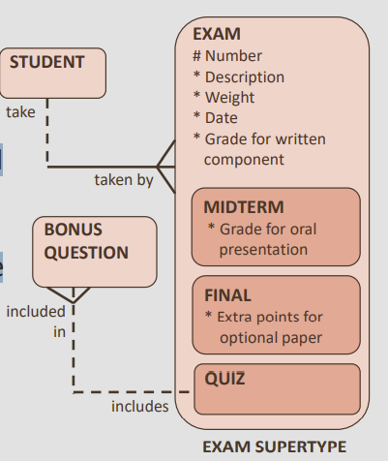
Supertype Example
EXAM is a supertype of QUIZ, MIDTERM, and FINAL
The subtypes have several attributes in common
These common attributes are listed at the supertype level (Generalization)
Subtypes inherit all attributes and relationships of the supertype entity (Specialization)

Slide 11
Always More Than One Subtype
When an ER model is complete, subtypes never stand alone
In other words, if an entity has a subtype, a second subtype must also exist, this makes sense
A single subtype is exactly the same as the supertype
This idea leads to the two subtype rules:
  Exhaustive: Every instance of the supertype is also an instance of one of the subtypes.
  All subtypes are listed without omission
  Mutually Exclusive(Disjoint vs Overlap): Each instance of a supertype is an instance of only one possible subtype

Slide 12
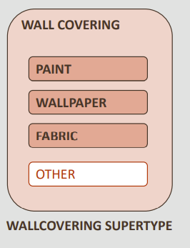
Always More Than One Subtype
At the conceptual modeling stage, it is good practice to include an OTHER subtype to make sure that your subtypes are exhaustive
  that you are handling every instance of the supertype

Slide 13
Correctly Identifying Subtypes
When modeling supertypes and subtypes, you can use three questions to see if the subtype is correctly identified:
  Is this subtype a kind of supertype?
  Have I covered all possible cases? (exhaustive)
  Does each instance fit into one and only one subtype? (mutually exclusive)

Slide 14
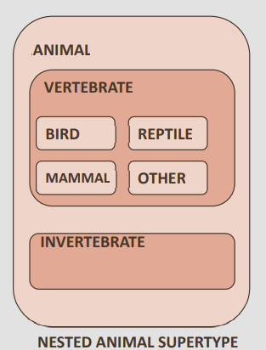
Nested Subtypes
You can nest subtypes
For ease of reading – “readability” -- you would usually show subtypes with only two levels, but there is no rule that would stop you from going beyond two levels

Slide 15
Exclusive OR relationship (ARC)
Mutually exclusive relationships sometimes exist between entities and are also known as Exclusive OR Relationships
An Exclusive OR relationship is a relationship between one entity and two (or more) other entities where only one of the relationships can exist at a time
In ERDs, we model this type of relationship with an Arc
Exclusive OR: A logical operator that returns a true value if one, but not both, of its operands is true.
Exclusive OR relationship: another term for a mutually exclusive relationship

Slide 16
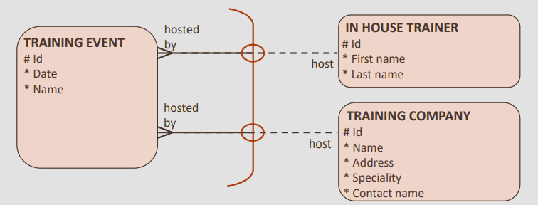
Exclusive OR Relationship
For example:
  a TRAINING EVENT can be hosted by either an IN HOUSE TRAINER or an external TRAINING COMPANY
  Each TRAINING EVENT must be hosted by one and only one IN HOUSE TRAINER OR one and only one TRAINING COMPANY
It cannot be both, so only one of the relationships can exist at a time. This is an example of an Exclusive OR Relationship

Slide 17
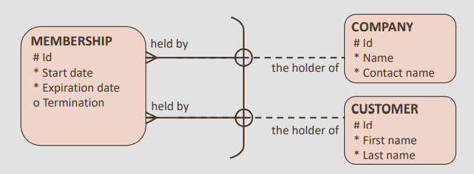
Exclusive OR Relationship
For example:
  each MEMBERSHIP must be held by one COMPANY or must be held by one CUSTOMER, but not both
NOTE: In this case, the business rules state that MEMBERSHIPS are only valid until the expiration date, so a COMPANY or CUSTOMER may have one or more MEMBERSHIPS.

Slide 18
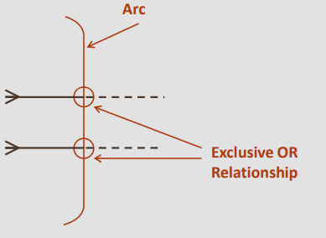
Representing Exclusive OR Relationships in the ERD
  An arc is represented on an ERD as a solid line with curved ends
  A circle is drawn on the arc for every relationship that is part of the arc
  All relationships in an arc must be mandatory or all must be optional
If a relationship crosses an arc but it is not part of the Exclusive OR Relationship, the circle is omitted. Where possible, for clarity and ease of reading the diagram, this should be avoided by drawing relationships that are not part of the arc outside the arc.

Slide 19
Arcs, Supertypes, and Subtypes
  Arcs and Super/subtypes both model mutual exclusiveness
  Certain situations are best modeled as an arc, and others as supertype and subtypes
  It can be confusing as to when to use an arc vs. a supertype/subtype.
  Super/subtypes are Mutually exclusive – in other words, each instance of a supertype is an instance of only one possible subtype.
  Arcs represent a Mutually exclusive relationship.

Slide 20
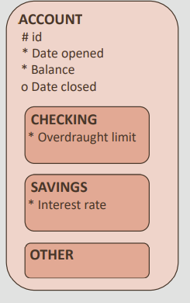
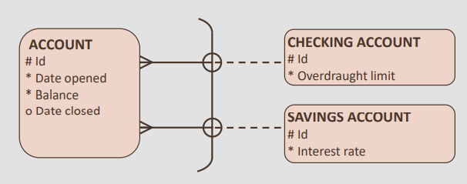
Arcs, Supertypes, and Subtypes
Example 1: −CHECKING ACCOUNT and SAVINGS ACCOUNT are “types” of ACCOUNT
This should be modeled as supertype and subtypes
Use supertypes/subtypes when you want to represent classifications or types of things.

Slide 21
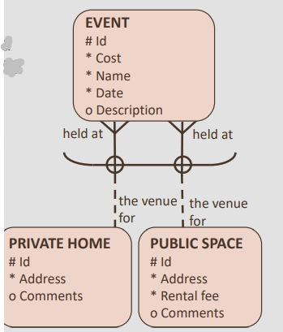
Arcs, Supertypes, and Subtypes
Example 2:
  An EVENT can be held at either a PRIVATE HOME or a PUBLIC SPACE −If the entities that are related through the arc are similar, there may be a case for creating a super/subtype without an arc

Slide 22
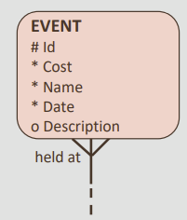
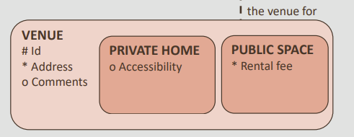
Arcs, Supertypes, and Subtypes
Example 2:
  In this case, both PRIVATE HOME and PUBLIC SPACE are types of VENUE, and they have broadly similar attributes, so they could be supertype and subtypes

Slide 23
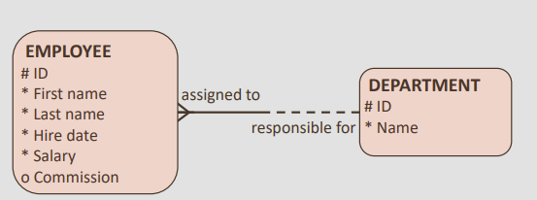
Relationship Transferability
Transferability:
  Can an EMPLOYEE be transferred from one DEPARTMENT to another DEPARTMENT?
  yes, an EMPLOYEE can change from one DEPARTMENT to another. This makes the relationship transferable.
  Once a class has been allocated to a teacher, can that class later be transferred to another teacher, possibly in mid-semester?
  Usually yes, because if not, what would we do if the original teacher becomes sick?

Slide 24
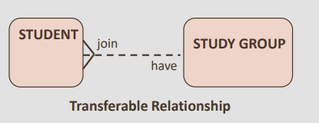
Relationship Transferability
Transferability:
  A STUDENT being allowed to move from one STUDY GROUP to another
  There is a relationship between STUDENT and STUDY GROUP that is transferable

Slide 25
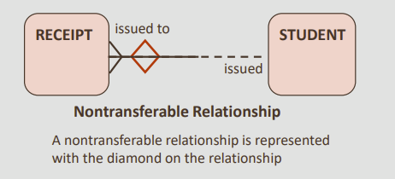
Relationship Transferability
Nontransferable
  If the transferability of a relationship is false, the relationship is said to be nontransferable.
  A STUDENT can be issued a RECEIPT for paying tuition fees, taking a certification exam, or purchasing items at the bookstore
  Once a RECEIPT has been issued, it cannot be transferred to another STUDENT
  If it was issued in error, it would have to be cancelled, and another RECEIPT would have to be written up
  The relationship between STUDENT and RECEIPT is nontransferable

Slide 26
Relationship Transferability
Nontransferable
  Nontransferable relationships are important to note because they usually reflect a business rule and will have implications when the ERD is implemented as a database.
  A nontransferable relationship is represented with the diamond on the relationship
  The diamond is typically drawn on the “many” (crows-foot) side of the relationship.

Slide 27
Terminology
Key terms used in this lesson included:
  Exhaustive
  Mutually exclusive
  Subtype
  Supertype
  Exclusive OR relationship
  Transferable
  Nontransferable

Slide 28
Try It / Solve It
  A show ticket is purchased from an agent, the box office, or the Internet.
  A ticket has a description, an event, a date and a price.
  An agent has a name and a phone number. The box office has an address and a phone number.
  The Internet has a URL address.
Draw the entities and represent the mutually exclusive relationship

Slide 29
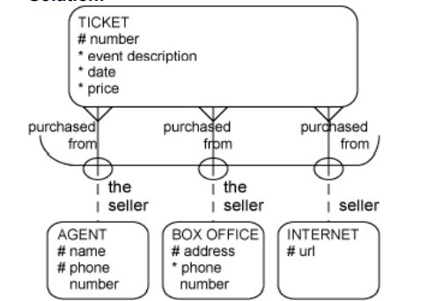
Solution

Slide 30
Try It / Solve It
  Draw the MENU entity as a supertype of the PROMOTIONAL, REGULAR, and OTHER entities.
  The UID of MENU is code. MENU is related to FOOD ITEM through this relationship:
    each MENU may contain one or more FOOD ITEMs, and each FOOD ITEM must be listed on one and only one MENU.
    The UID of FOOD ITEM is a barred UID using its attribute “number”.
    Add appropriate attributes to the other entities and be ready to defend your choices
    Draw the entities and represent the mutually exclusive relationship

Slide 31
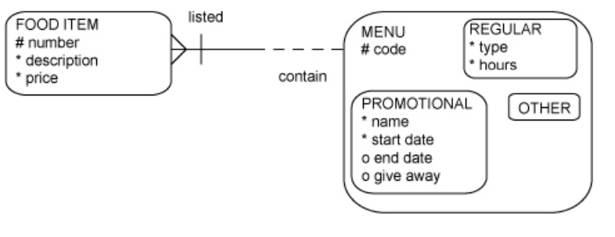
Solution
answers will vary

Slide 32
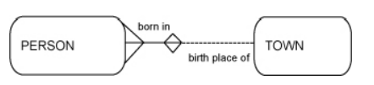
Try It / Solve It
Draw ERDs for each of the following. Draw softboxes, relationship lines, and labels for each relationship in both directions. Indicate non-transferability when appropriate.
  Each town may be the birthplace of many people. Each person must be born in one and only one town
  Each room may house one or more guests. Each guest may stay in one and only one room
  Each employee must work for one and only one department. Each department may have one or more employees
  Each hotel may be the host of one or more guests. Each guest may be hosted in one or more hotels.
  Each message must be addressed to one or more persons. Each person may be the addressee of one or more messages (non-transferable).

Slide 33
Try It / Solve It
Draw ERDs for each of the following. Draw softboxes, relationship lines, and labels for each relationship in both directions. Indicate non-transferability when appropriate.
  Each garment must have one and only one price. Each price may be for one or more garments.
  Each airline coupon must be used for one and only one destination. Each destination may be visited with one or more coupons. (transferable or non-transferable?)
  Each automobile must use one and only one tire size. Each tire size may be used by one or more automobiles.
  Each child must have one and only one biological mother. Each mother must be the parent of one or more children.
  Each person must be of one and only one blood type. Each blood type may classify one or more persons.

Slide 34
Try It / Solve It
Draw ERDs for each of the following. Draw softboxes, relationship lines, and labels for each relationship in both directions. Indicate non-transferability when appropriate.
  A person may be on one or more junk-mail lists. Each junk list may contain one or more persons.
  Each student may learn from one or more teachers. Each teacher may educate one or more students
  Each school may be attended by one or more honor students. Each honor student must attend one and only one school.
  Each fingerprint must belong to one and only one person. Each person must have one and only one fingerprint

